Slide 1

HARMFUL GASES IN THE CZECH REPUBLIC AND OUR REGION
C4 MOBILITY IN HELMOND
22nd January – 29th January 2023
Project No. 2020-1-CZ01-KA229-078153_1_Happy, Healthy, Wise and Wealthy

Slide 2

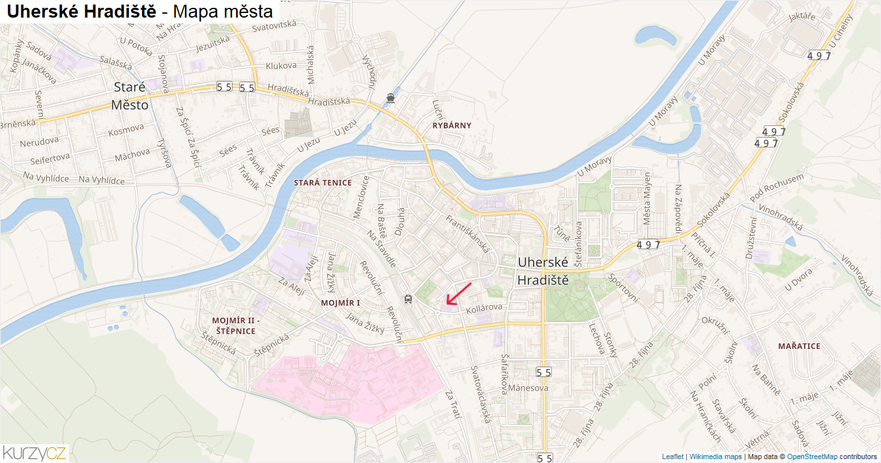
OUR TOWN UHERSKÉ HRADIŠTĚ
Location: South Moravian region close to the Slovakian border
25 000 inhabitants
A number of elementary and secondary schools
Unesco school = the centre of the town
Advantages: walking distance to all important places, job opportunities for people who live close by
Disadvantages: a lot of traffic, frequent traffic jams during rush hours

Slide 3
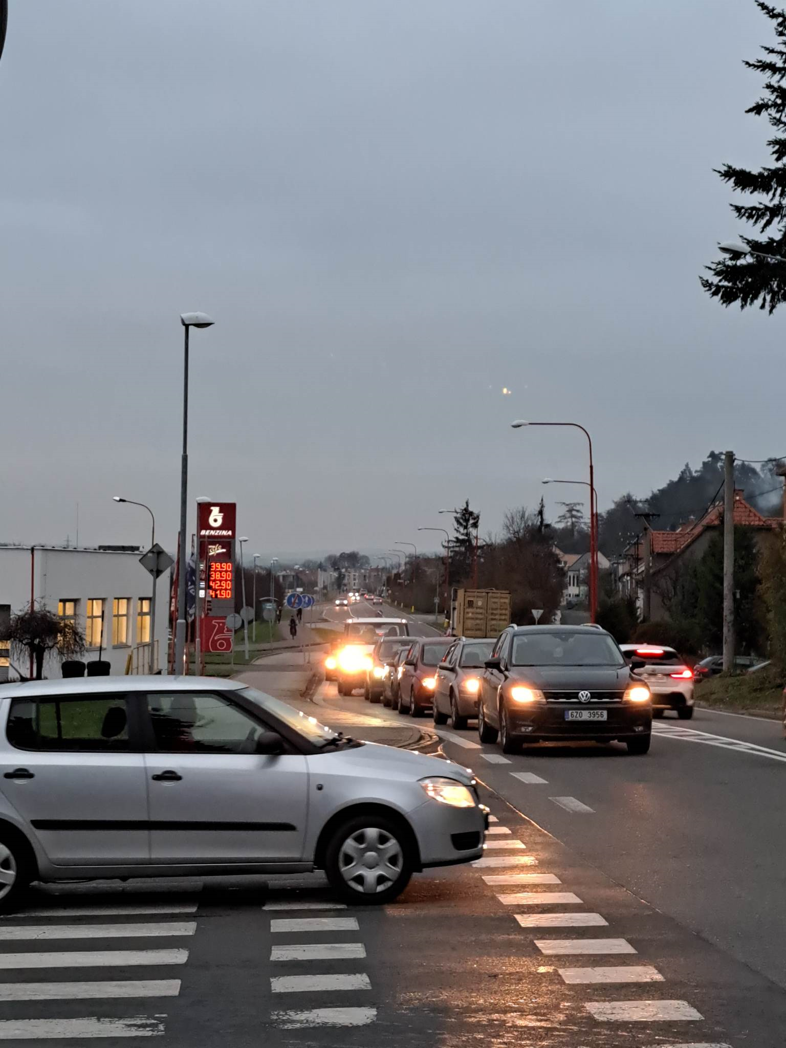
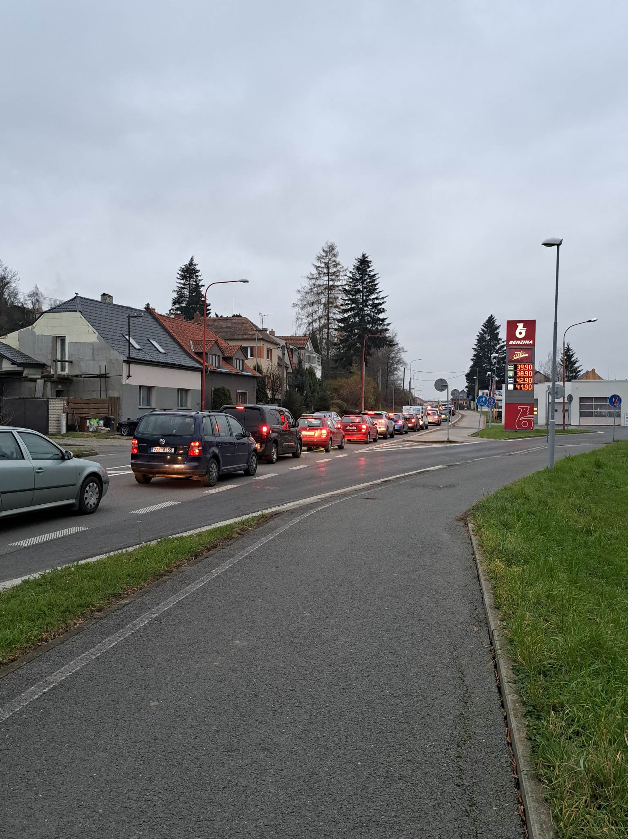
TRAFFIC/PUBLIC – PRIVATE TRANSPORTATION
Commuting of a lot of people on daily basis
Train station/bus station – not used frequently enough
Traffic jams at the most important crossroads
Bike riders risk their lives
Air pollution and smog - big issues here

Slide 4
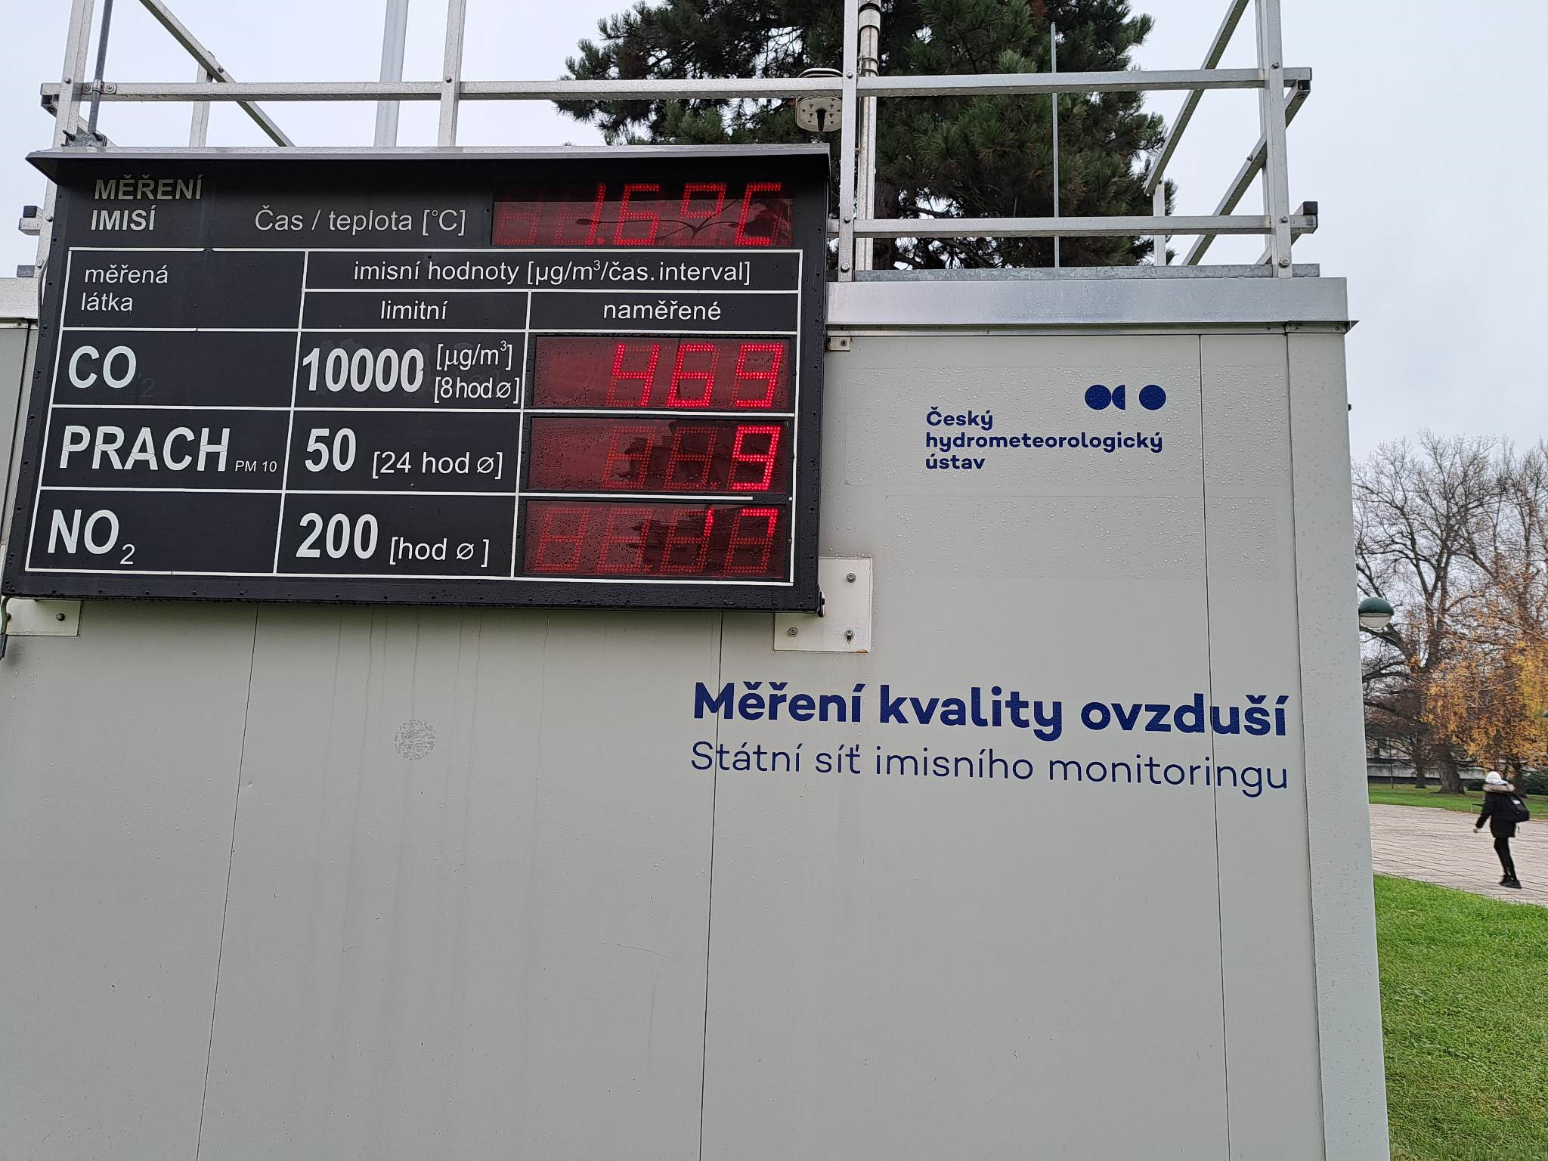
MEASURING OF AIR POLLUTION IN THE TOWN
This station measures the quality of the air
The screen shows the levels of different substances in the air
Location: the main (the most frequently used) crossroads in the middle of the town
The owner: Czech hydrometeorological institute
All these chemicals pollute the air in here

Slide 5
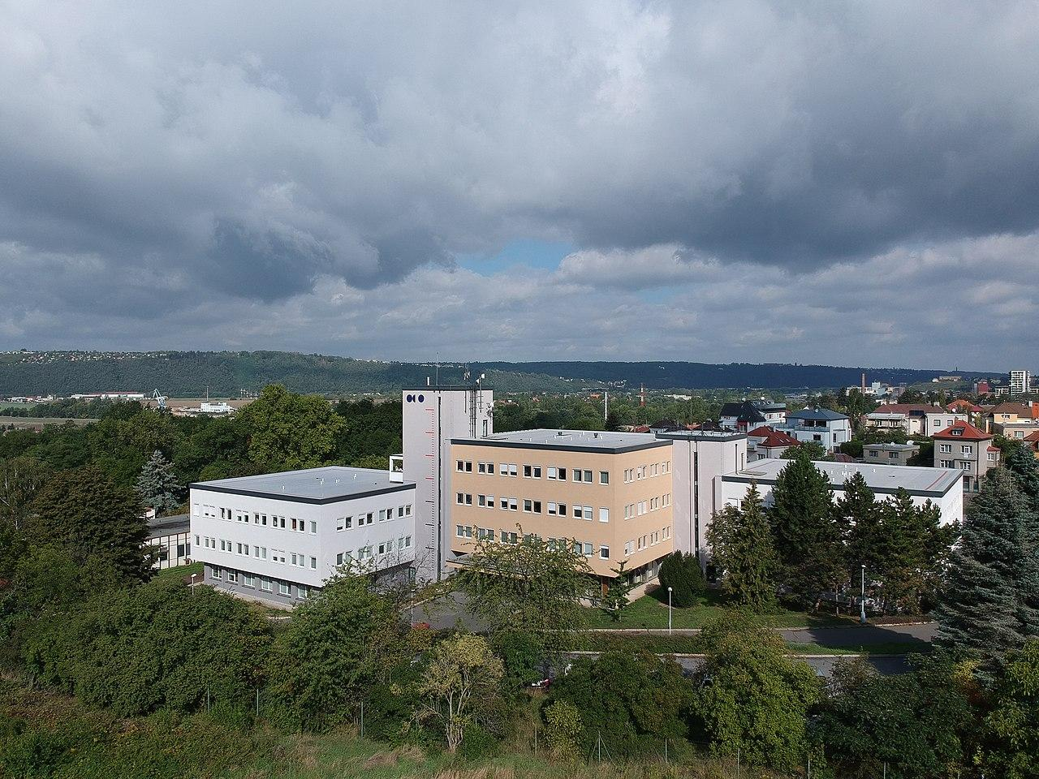
CZECH HYDROMETEOROLOGICAL INSTITUTE
Central state office: air quality, meteorology, climatology and hydrology
An organization established by the Ministry of the Environment of the Czech Republic
One of the most important sections: air quality section
Headquarters: Prague

Slide 6
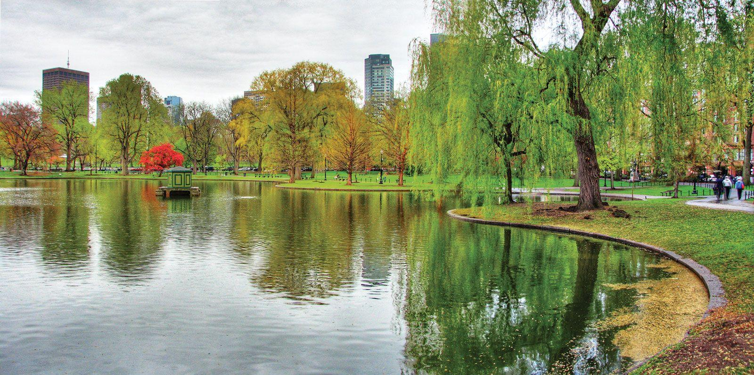
REDUCTION OF TRAFFIC IN THE AREA OF UHERSKÉ HRADIŠTĚ
Traffic outlet from the city- a new highway
The air can get better by diverting transit traffic outside the city- the trucks don‘t have to go through the city
Planting more greenery- parks

Slide 7
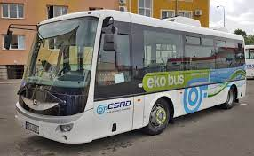
MASS TRANSPORT SOLUTIONS
Renewal of the vehicle fleet
Replacement of some diesel buses with natural gas
Adding new bus stops for urban transport so that people don‘t have to drive as many cars

Slide 8
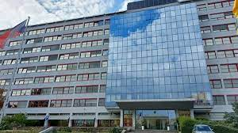
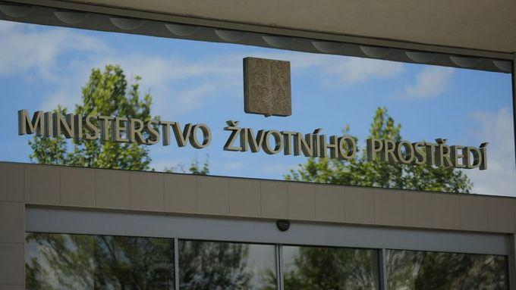
MINISTRY OF THE ENVIRONMENT OF THE CZECH REPUBLIC
is the central state administration body for:
protection of natural water accumulation
protection of water resources and protection of underground and surface water quality
air, nature and landscape protection
performance of the state geological service
protection of the rock environment, including the protection of mineral resources and groundwater
geological work and environmental supervision of mining
waste management and other

Slide 9

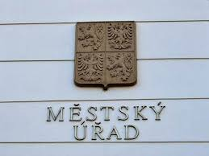
WATER AUTHORITY AND ENVIRONMENT DEPARTMENT
IN OUR TOWN
nature and lanscape protection
protection of the agricultural land fund, protection of animals against cruelty
forestry
hunting and fishing
waste management
Air protection:
  performs state administration in the area of ​​air protection in accordance with the Act on Air Protection,
  deals with physical offenses and administrative offenses of legal entities within the scope of its competence.

Slide 10
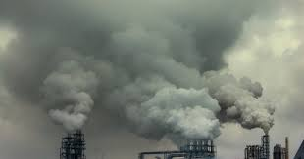

Air Protection Act
legislative framework on air protection and prevention of air pollution
the most important legal document dealing with air protection
issued by the Ministry of the environment in 2012
56 articles divided into eight Sections (elaborate)

Slide 11
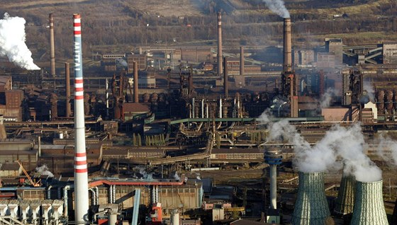
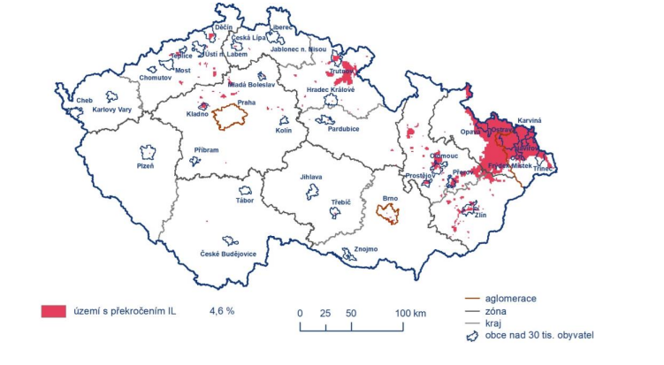
AIR POLLUTION OF THE CZECH REPUBLIC
The Czech Republic is coverd with 4,6 % by ozone and other harmful substances
The biggest pollution is in Ostrava due to coal mining and large-scale production in factories
There are not so many factories in the region of Uherské Hradiště so our town is not that big polluter and does not affect much the pollution

Slide 12
Thank you for your attention ☺

